Slide 1



Introduction to Retail Customer Segmentation
Understanding the Role of Data in Customer Clustering
Significance of Customer Segmentation
Tailors marketing strategies to diverse customer needs, improving business outcomes.
Retail Data Insights
Provides actionable insights from purchase behaviors and demographics.
Data-Driven Strategies
Enables targeted campaigns, increasing ROI and customer satisfaction.
Notes:
Customer segmentation in retail is crucial for personalizing the shopping experience. By analyzing transactional and demographic data, businesses can group customers into segments with shared characteristics. This process helps in crafting marketing strategies that resonate with specific customer groups, enhancing both customer satisfaction and revenue. We’ll begin by exploring the dataset and methodologies used for clustering.

Slide 2

Data Analysis and Cluster Creation
Unveiling Patterns in Customer Behavior
Dataset Overview: Analyzed retail data including purchase frequency, average spend, and demographics.
Clustering Methodology: K-Means algorithm applied to segment customers based on behavioral traits.
Cluster Visualization: Generated visual plots to interpret cluster distributions and overlaps.
Photo by ev on Unsplash
Notes:
The first step in our analysis was to delve into the dataset, which included key variables such as purchase frequency, customer demographics, and average spend. Using the K-Means algorithm, we segmented customers into distinct groups, identifying patterns and similarities. This clustering process is essential for developing targeted marketing strategies. Visualizations were crucial in understanding how these clusters differ and overlap, setting the stage for a more nuanced analysis.

Slide 3
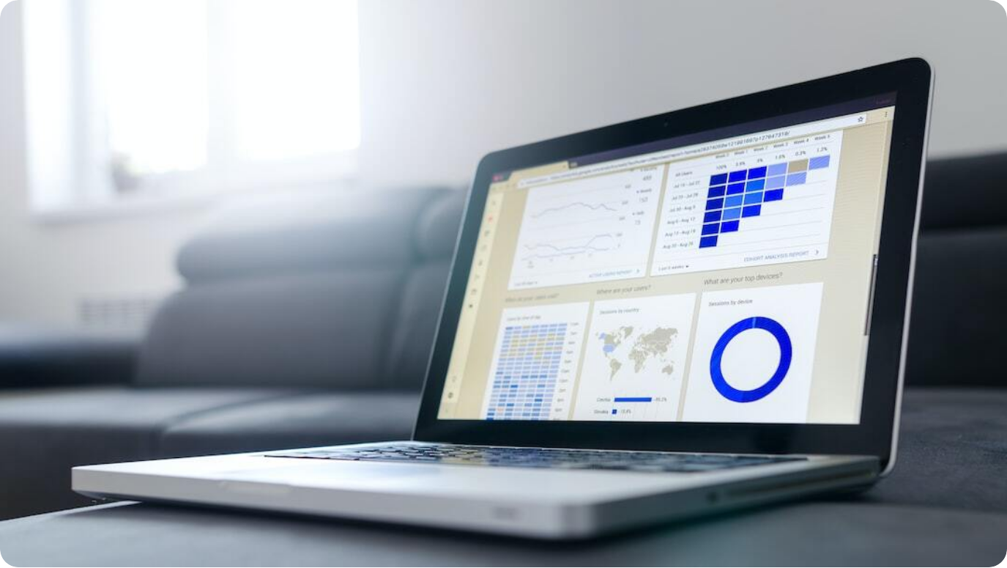
Understanding Cluster Behaviors
Profiling Each Customer Group
Cluster 1: High-Value Customers: Frequent buyers with high average spend. Ideal for premium campaigns.
Cluster 2: Bargain Seekers: Price-sensitive, reactive to discounts and promotions.
Cluster 3: Occasional Shoppers: Low purchase frequency, potential for re-engagement strategies.
Photo by Lukas Blazek on Unsplash
Notes:
Each cluster revealed distinct customer behaviors. High-Value Customers are brand loyal and consistently spend more, making them prime targets for premium campaigns. Bargain Seekers focus on value and respond well to discounts, driving volume during sales. Lastly, Occasional Shoppers present opportunities for re-engagement through personalized offers, maximizing their limited interaction.

Slide 4



Regression Analysis for Campaign Success
Optimizing Marketing Strategies Using Data
Predictive Modeling
Regression analysis identifies key predictors of campaign success across clusters.
Targeted Recommendations
Tailored campaigns designed for each cluster based on regression insights.
Optimized Resource Allocation
Maximizes ROI by focusing on high-impact segments.
Notes:
Regression analysis plays a pivotal role in refining marketing strategies. By identifying predictors of campaign success, such as customer demographics and spending habits, it provides data-driven recommendations for each cluster. This ensures that resources are allocated effectively, focusing on segments that promise the highest returns.

Slide 5



Key Insights and Conclusion
Strategic Takeaways from Data Analysis
Data-Driven Segmentation
Identified distinct customer clusters with unique behaviors.
Targeted Marketing Success
Regression models informed effective, personalized campaigns.
Strategic Recommendations
Focus on high-value and re-engagement strategies to optimize ROI.
Notes:
In conclusion, customer segmentation has proven invaluable in enhancing retail marketing strategies. By clustering customers and understanding their unique behaviors, we can craft highly personalized and effective campaigns. Regression analysis further refines these strategies, ensuring every marketing dollar is well-spent. The next steps involve implementing these insights to drive business growth.

